Slide 1
Assessment for Learning — Using ExamSoft for Formative Assessment
Dan Thompson, M.Ed.
Manager of Instructional Design and Educational Technology
Oklahoma State University Center for Health Sciences

Slide 2
Session Objectives
Determine the best method(s) of formative assessment to implement for your lesson/content
Create valuable formative assessments to improve student outcomes

Slide 3
Why Use Formative Assessment
Use of formative assessment can improve:
Student self-awareness
Faculty awareness of student knowledge
Student outcomes

Slide 4
More “Why”? – Why not?
Other benefits to formative assessment:
Engages students with content
Makes class more fun…yes, class is allowed to be fun!
Communication with students
Use assessments for learning
Make students comfortable with Examplify in a low stress environment

Slide 5
Goals/Objectives
Remember your purpose
Align formative assessments with learning objectives, instructional methods, and summative assessments

Slide 6
Pre-class Assessment
Method:
Include an ExamSoft assessment with pre-class assignments
Basic comprehension questions (mastery level items)
Have students complete assessment prior to class
Benefits:
Create in-class flexibility
Tailor your lessons to student needs
Highlight key concepts

Slide 7
Professional Clerkships/Rotations
Method:
Standardize rotations
Assess learning objectives
Tag items to objectives!
Encourage student self-assessment
Benefits:
Improve student outcomes
Satisfy accreditation requirements

Slide 8
Team-Based Activities
Method:
Create group-based assessments
Higher-order questions (discriminating items)
Designate team leaders to submit answers for their group
Benefits:
Promote active learning
Create peer driven collaborative learning

Slide 9
Exam Prep
Guided study
Difficult, multi-step items
Non-secure assessment – encourage students to actively look-up information
*Be aware of how you assign points

Slide 10
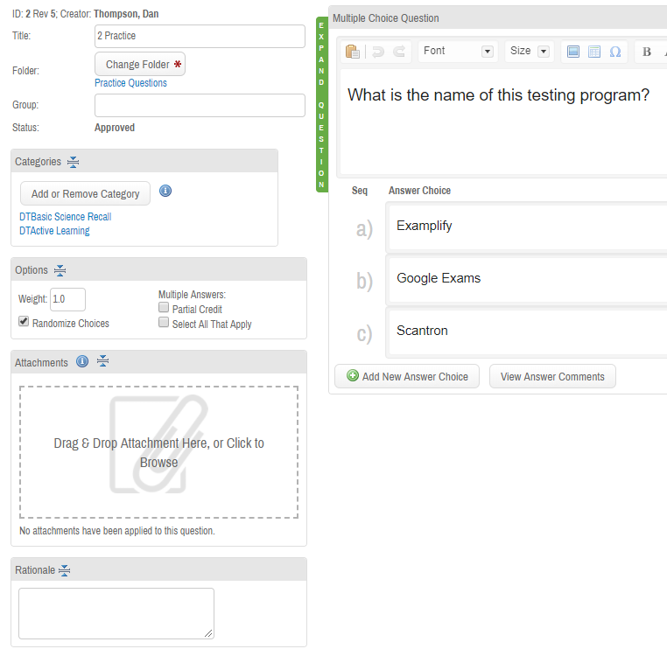
Feedback!
Feedback is the necessary final step of formative assessment
Timely
Quality
Rationale
Release results
Multiple choice/Rubrics

Slide 11
Tips/Tricks
Work smart not hard – use retired exam questions for formative assessments
Use exam item analytics to identify appropriate items
Remember your purpose for the activity
Add a rationale and release results
Create a tangible student guide for students

Slide 12
Thank you!
Questions/Comments?
Dan.thompson@okstate.edu
@danthompsonidts

